Slide 1








Lesson 1. Two way data binding in angular 4

Slide 2



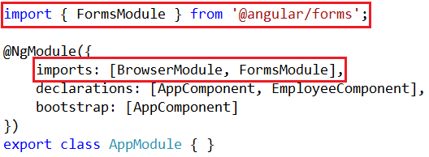

Two way Data Binding in Angular 4
Two way Data Binding in Angular 4
OR
Import ngModel directive from Angular system module called FormsModule

Slide 3

Two way Data Binding in Angular 4
Syntax for using two-way data binding in Angular
The square brackets on the outside are for property binding
The parentheses on the inside are for event binding
To easily remember this syntax, compare it to a banana in a box

Slide 4
Q & A
Contact:rashmipawaskar@synergetics-india.com

Slide 5
Thank You

